Slide 1
1150 Programming Logic Lists
Collections of data

Slide 2
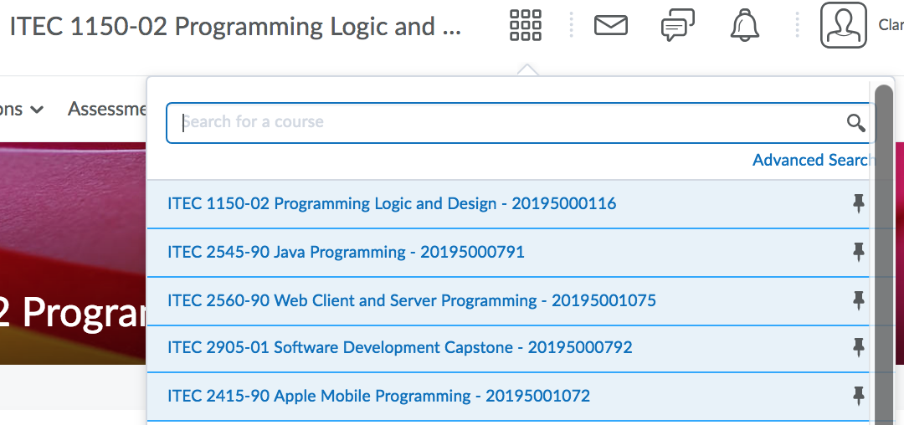
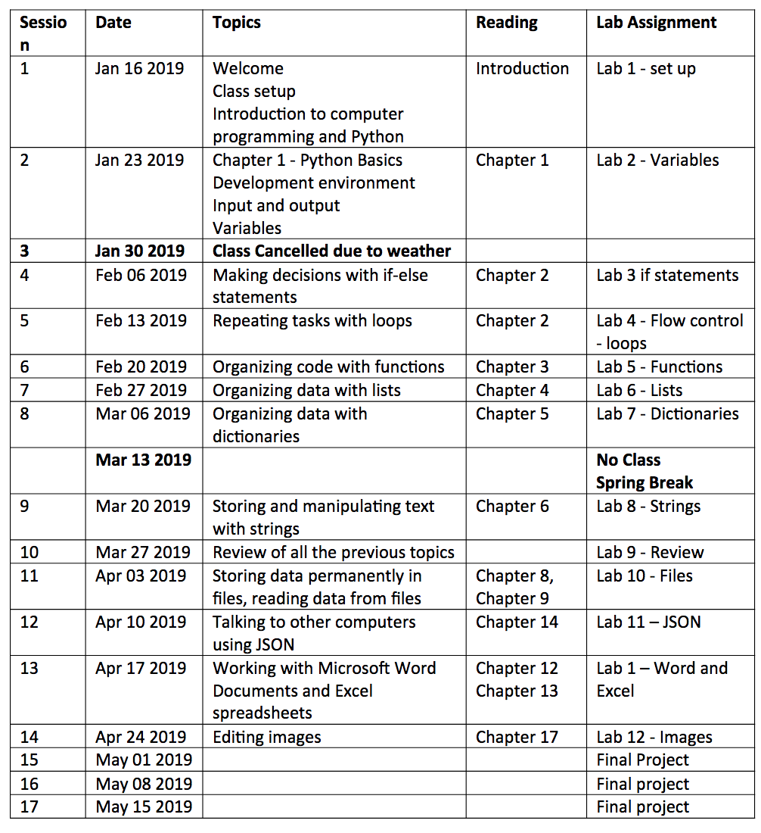
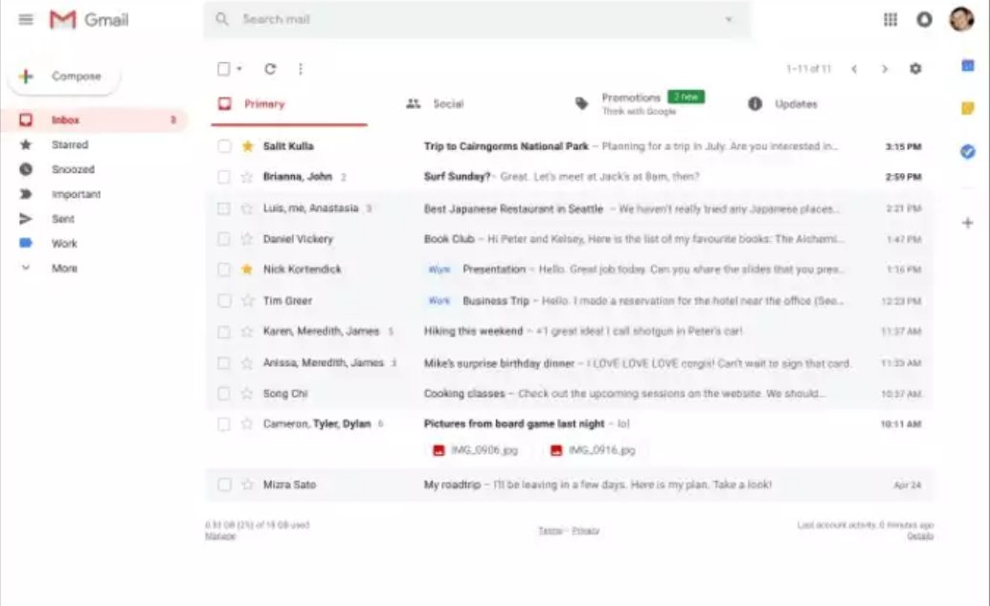
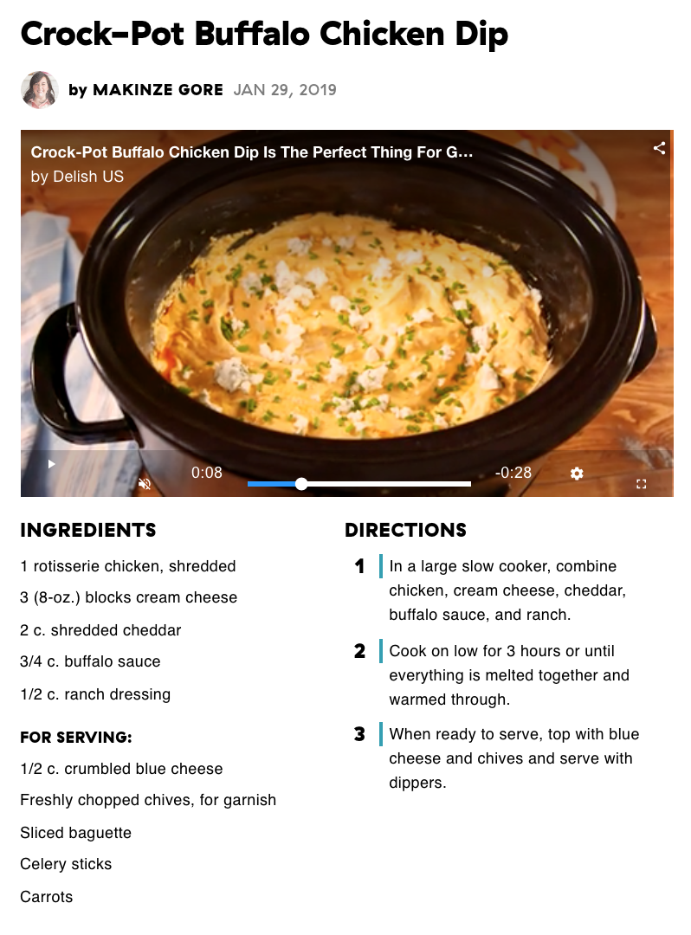
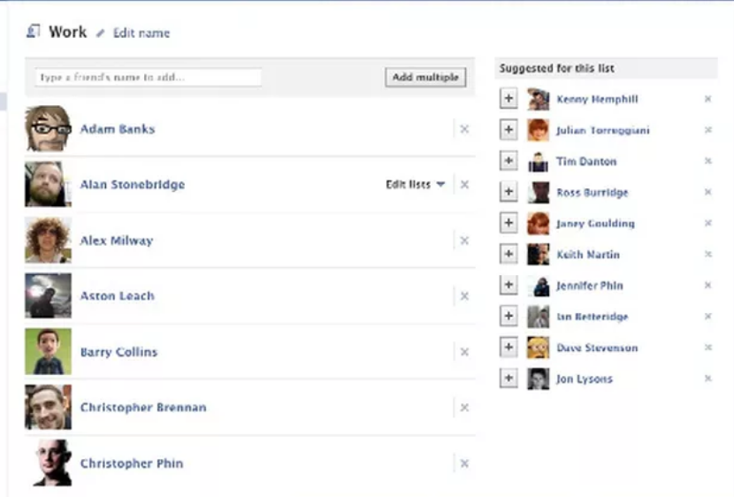

Lists are everywhere
List of classes in D2L
Friend list in social media apps
List of emails

Slide 3
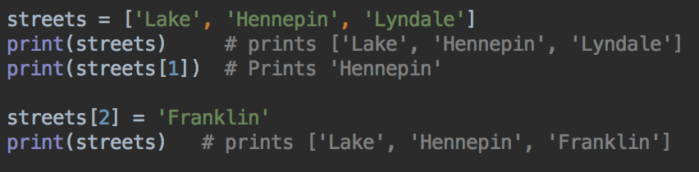
Lists
A group of items, usually of the same type, stored together
To define a list in Python, give it a name
Use square brackets [ ] to define the list
Separate the list items with commas
You can either refer to the whole list by its name
Or, you can refer to any of the list items by their position number - the list index

Slide 4
Lists
streets is the list name - a list of three Strings
In programming, we count from 0
streets[0] is 'Lake'
streets[1] is 'Hennepin'
streets[2] is 'Lyndale'
element 0
element 1
element 2

Slide 5
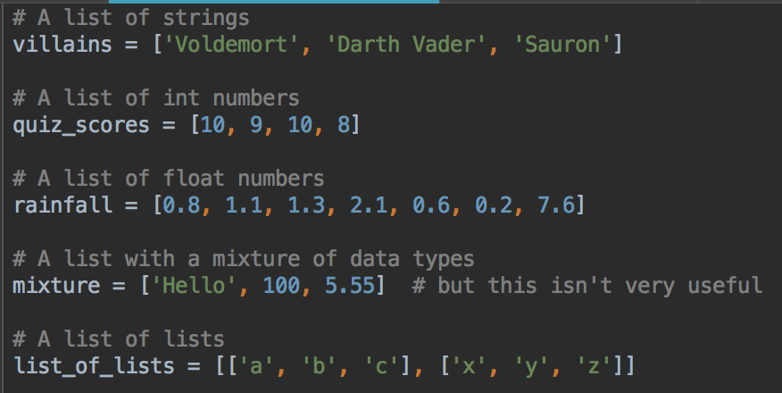
Python lists can contain different data types
Examples:
strings, integers, floats, even other lists

Slide 6
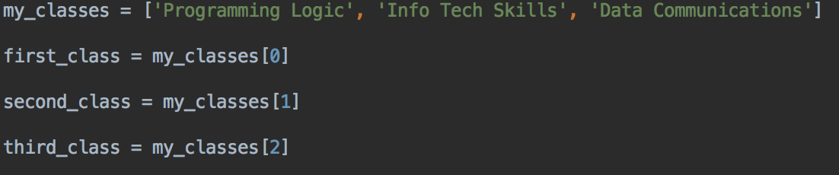
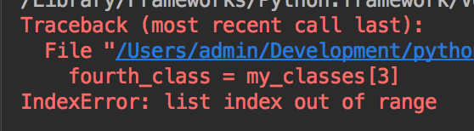
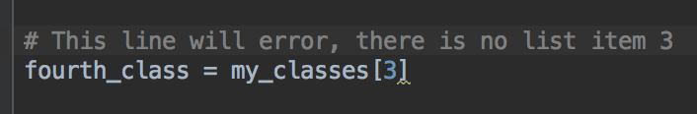
Accessing a list item - remember count from 0
What happens if this program tries to read my_classes[3] ?

Slide 7
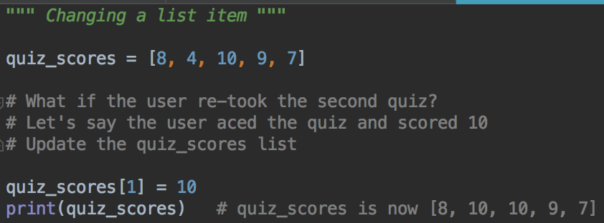
You can change list items

Slide 8
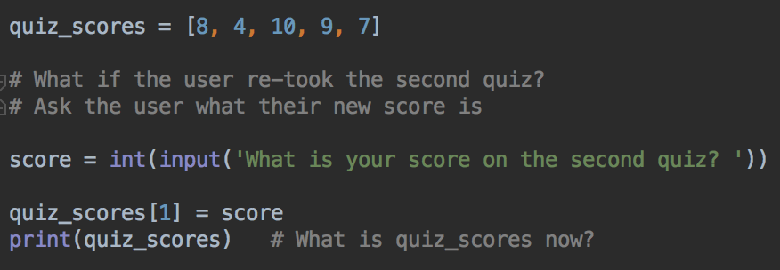
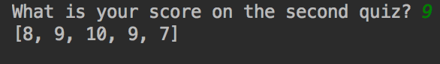
Changing list items with a variable
More common to work with variables, instead of literal data

Slide 9
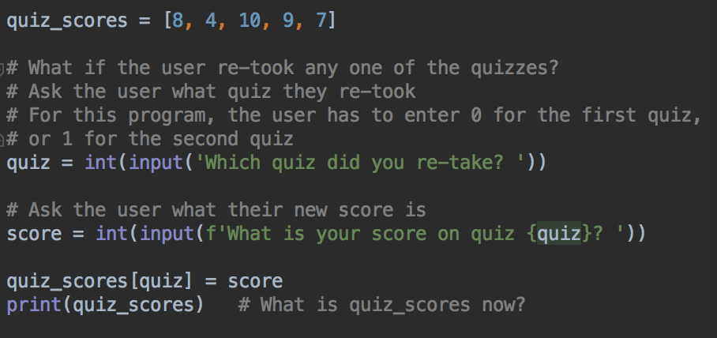
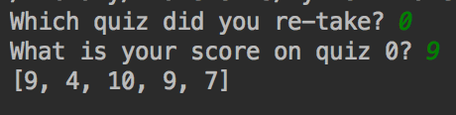
Changing list item - variable for index and data
Run and test this program
Is quiz_scores updated how you expected?

Slide 10
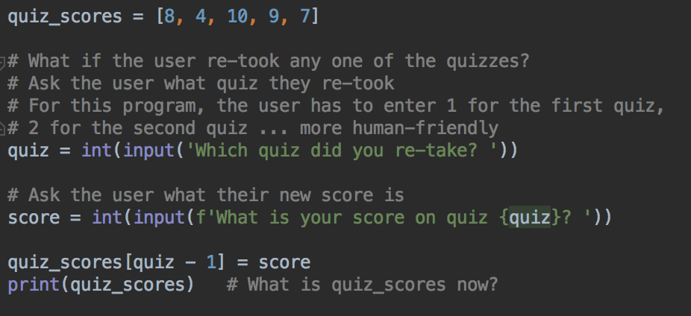
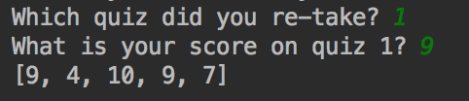
People don't usually count from 0
Modification so the user can enter 1 for the first quiz, 2 for the second quiz

Slide 11
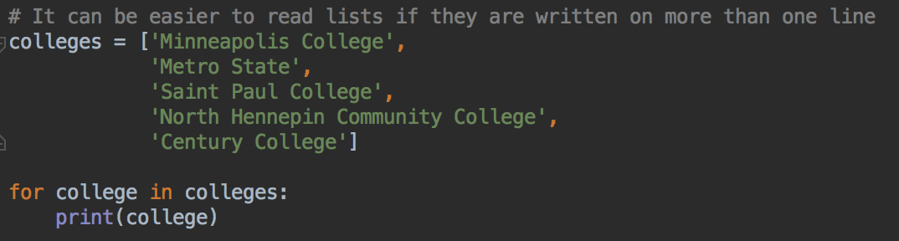
Lists & Loops
Lists and loops work well together
It's very common to process every item in a list in the same way
For example, to call a function on each list item
Or add each list item to a running total

Slide 12
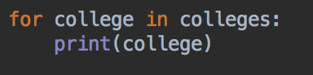
Lists and loops
This says "Repeat the loop for each item in the list in turn. Each time the loop repeats, call the list item 'college' and execute the loop body for this list item"
So the first time the loop repeats, college = 'Minneapolis College'
The second time the loop repeats, college = 'Metro State'

Slide 13
Your turn
Write the streets list
Print the first street (index 0)
Print the last street (index 2 - not 3!)
Change ‘Hennepin’ to ‘Portland’
Use a loop to print all the streets

Slide 14
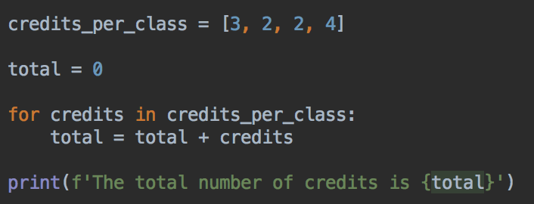
Loops
What's the total number of credits for all the classes?

Slide 15
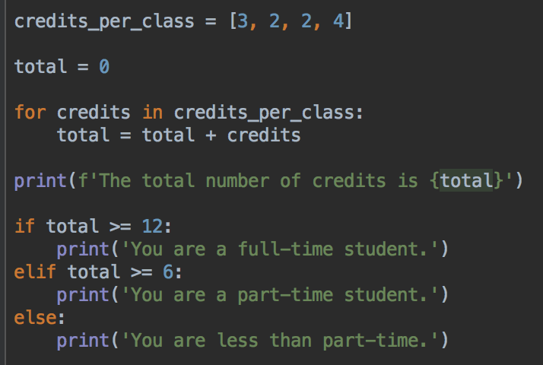
We can figure out if this is a full-time or part-time student

Slide 16
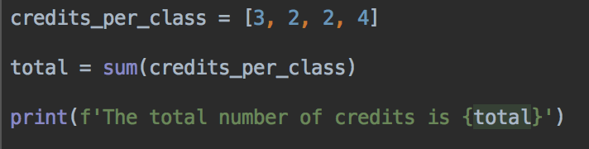
Python's built-in sum() function
Adding up lists is very common
So Python provides a sum() function

Slide 17
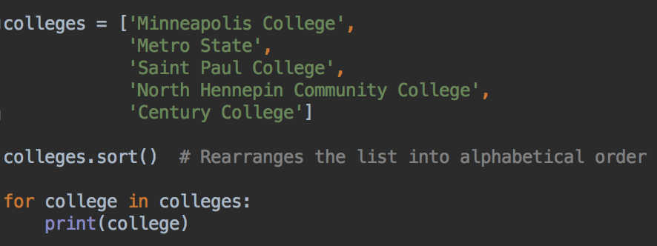
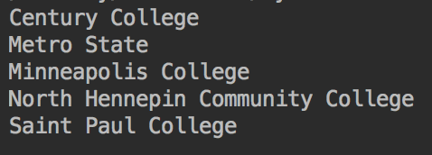
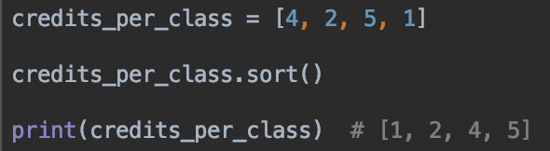
More useful built-in list functions: sort()
A list of numbers would be sorted from smallest to largest number, in numerical order

Slide 18
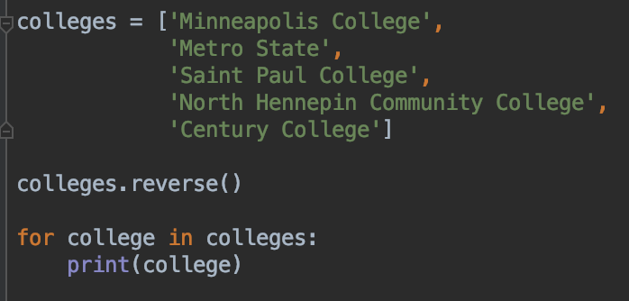
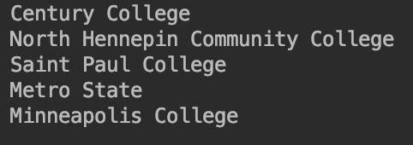
More useful built-in list functions: reverse()

Slide 19
Your turn
Start with this list (or make a list of your favorite 3-4 movies)
movies = ['Fargo', 'Up', 'Rocky', 'Jaws']
Can you print the movies in reverse alphabetical order?
Use a loop to print the movie titles

Slide 20
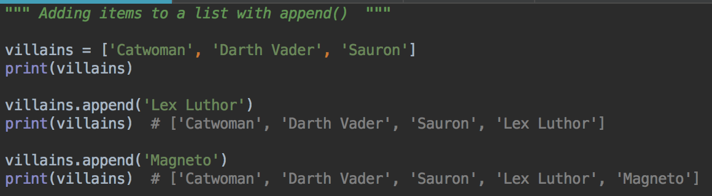
Adding things to a list with append()
Using the append method with villains list
Your turn: append your favorite movie to the movies list you just made

Slide 21
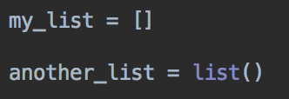
lists
You can initialize a variable to an empty list
Can be useful if you know you will be adding things to a list in your program
Two ways: either with empty [ ] or by calling list()

Slide 22
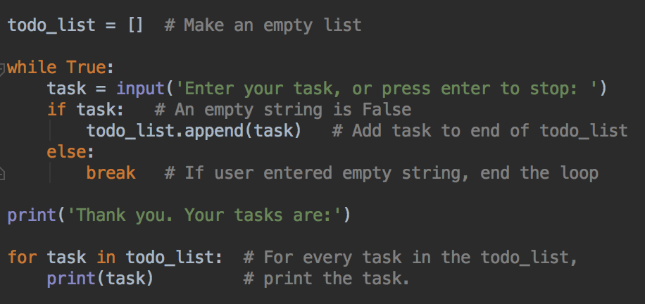
Adding Items to a list - task list program
Type this in, run and test

Slide 23
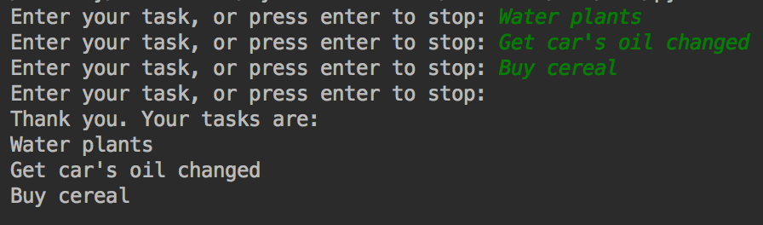
Example Output
An empty string is considered to be False, so can use that to stop the loop if the user does not type anything before pressing enter

Slide 24
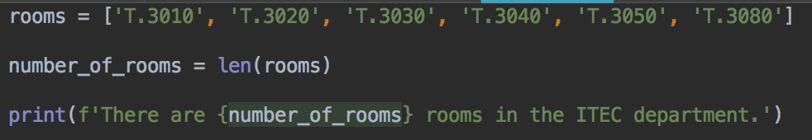
How many things in the list? len()
len() returns the number of elements in a list
Your turn: use len() to print the number of movies in your movies list

Slide 25
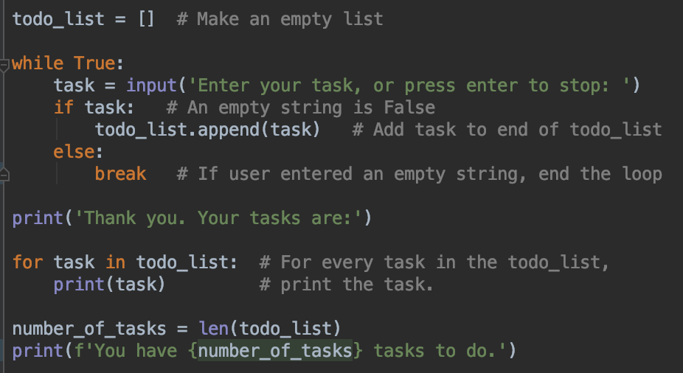
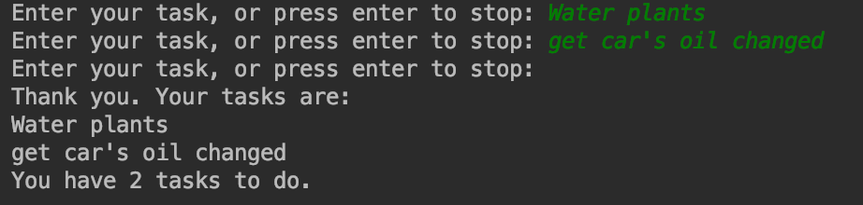
Modify the task list program to print the number of tasks

Slide 26
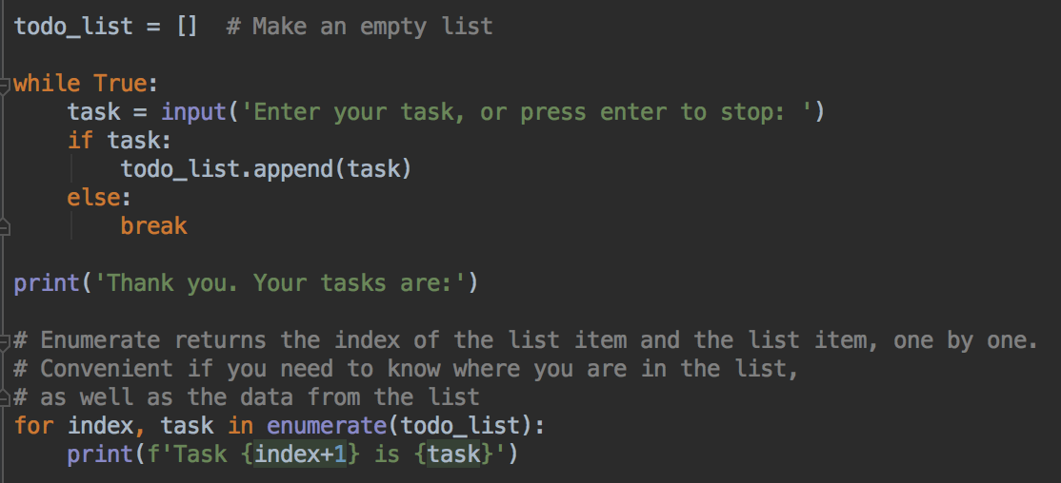
enumerate() - counting index and item when looping
Modify the loop to use enumerate()
Run and test. What does this program print?

Slide 27
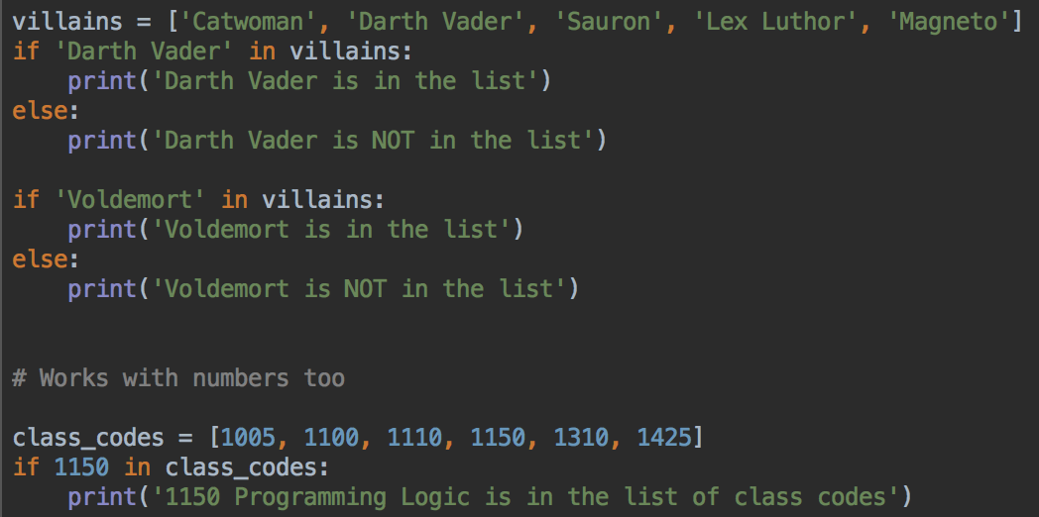
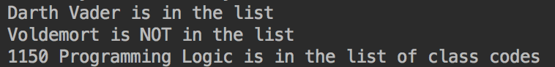
in operator for testing if an item is in a list
in is case sensitive, it checks for an exact match.
So 'darth vader' is not in the list

Slide 28
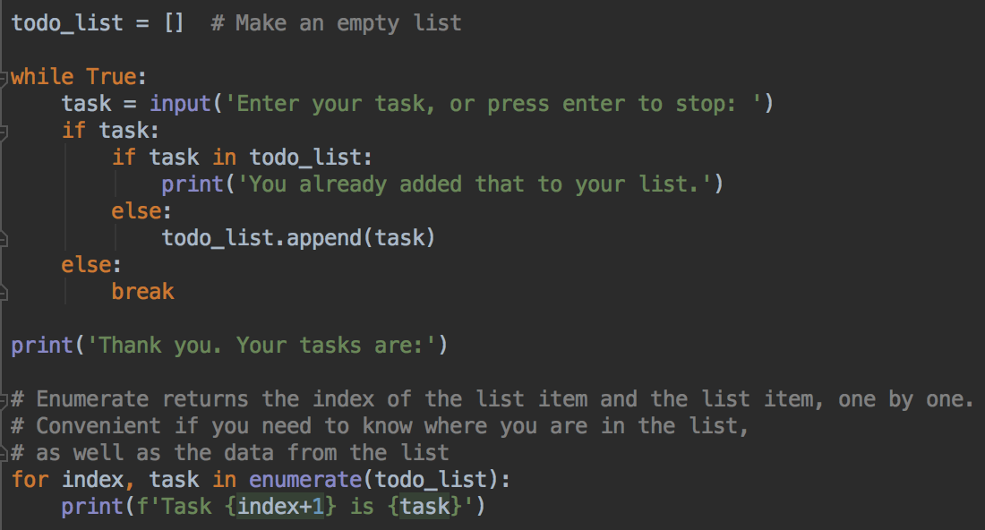
So, can avoid duplicates in the to do list
Modify your program, run and test

Slide 29
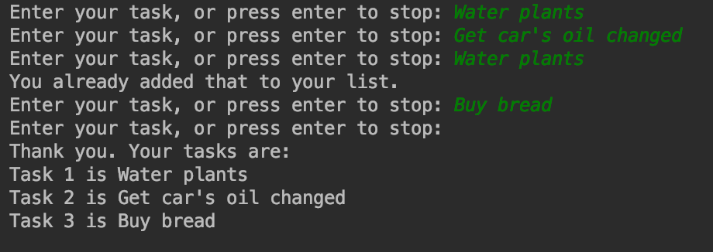
Output
Duplicates are not added
Extra question - how can you make this check case insensitive?

Slide 30
Removing things from a list
Two ways:
Use pop() if you know where in the list you want to remove the item from – what position?
Use remove() if you know what you want to remove

Slide 31
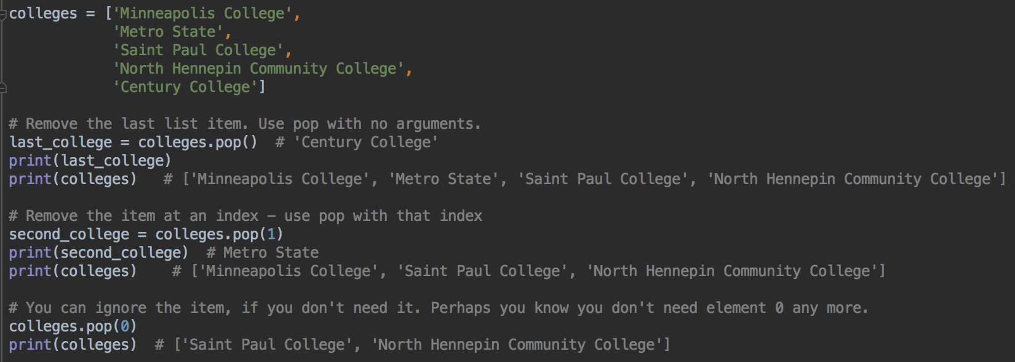
pop() - remove by index (position in list)
pop() can be called with an argument to remove the item at that index
Or it can be called with no argument, and it removes the last list item
What happens if you try to remove an index that doesn't exist?

Slide 32
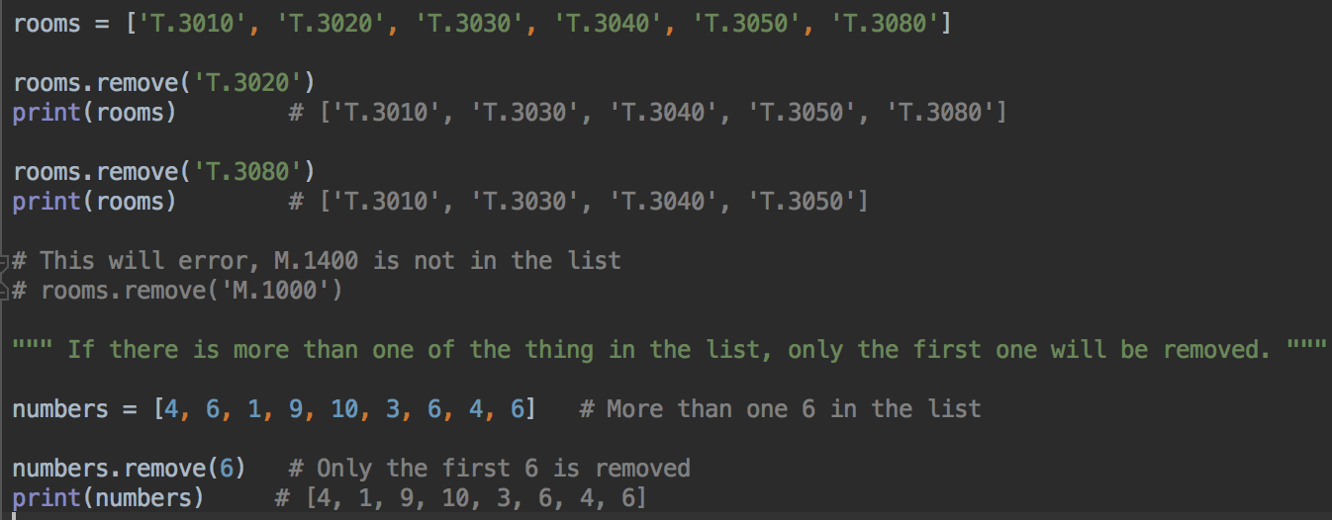
remove() - removing an item from a list
It's an error to try to remove an object that is not in the list

Slide 33
Remove Vs. Pop Vs. Delete Methods
pop is good to remove the last item in a list, or if you know the index of the item that you want to get rid of
pop returns the list item it removed
remove is good if you know exactly how the item is spelled, or you know the exact value
remove gets rid of the first matching value
remove doesn't return anything
pop and remove both fail if the item you try to remove is not there.

Slide 34
Your turn
Use pop() to remove the last movie from your movie list
Print the list to verify it was removed
Use remove() to remove 'Jaws' from your movie list (or a movie of your choice, if you have different movies in your list
Print the list to verify it was removed

Slide 35
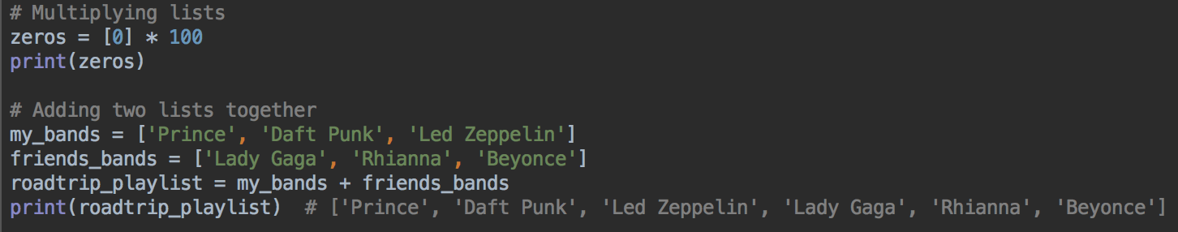
Using * and + with lists
Want a list of 100 zeros?
Want to add all the items in one list to all the items in another list?

Slide 36
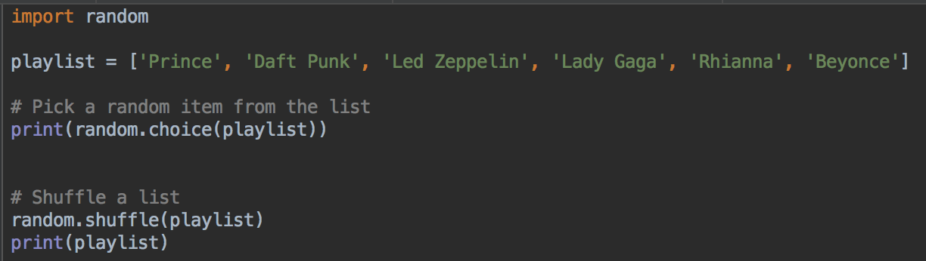
Random items
Using random methods with lists

Slide 37
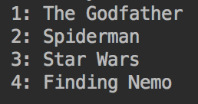
Your turn
Make a list of your favorite 4 (or 3 or 5 or 10) movies
Use shuffle to arrange the list in a random order
Use enumerate and a loop to print a numbered list, for example:

Slide 38
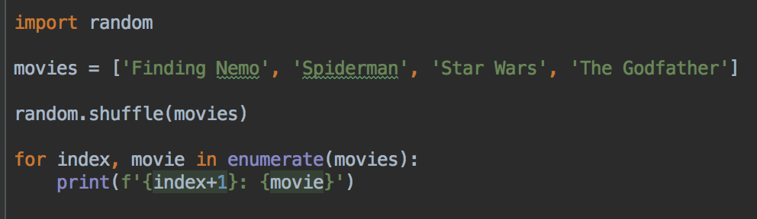
Random movie playlist
Example solution

Slide 39
Lists - summary
Lists are really useful
Lists are one of the most common data structures in Python
Learn how to create them, add data, remove data, use them in a loop for calculations and printing

